Slide 1
Capstone Project
Play Store App Review Analysis
By Vashu Garg(Lead), Palak Bindal, Somya Jain,
Deepika Gupta and Jyoti SIngh

Slide 2
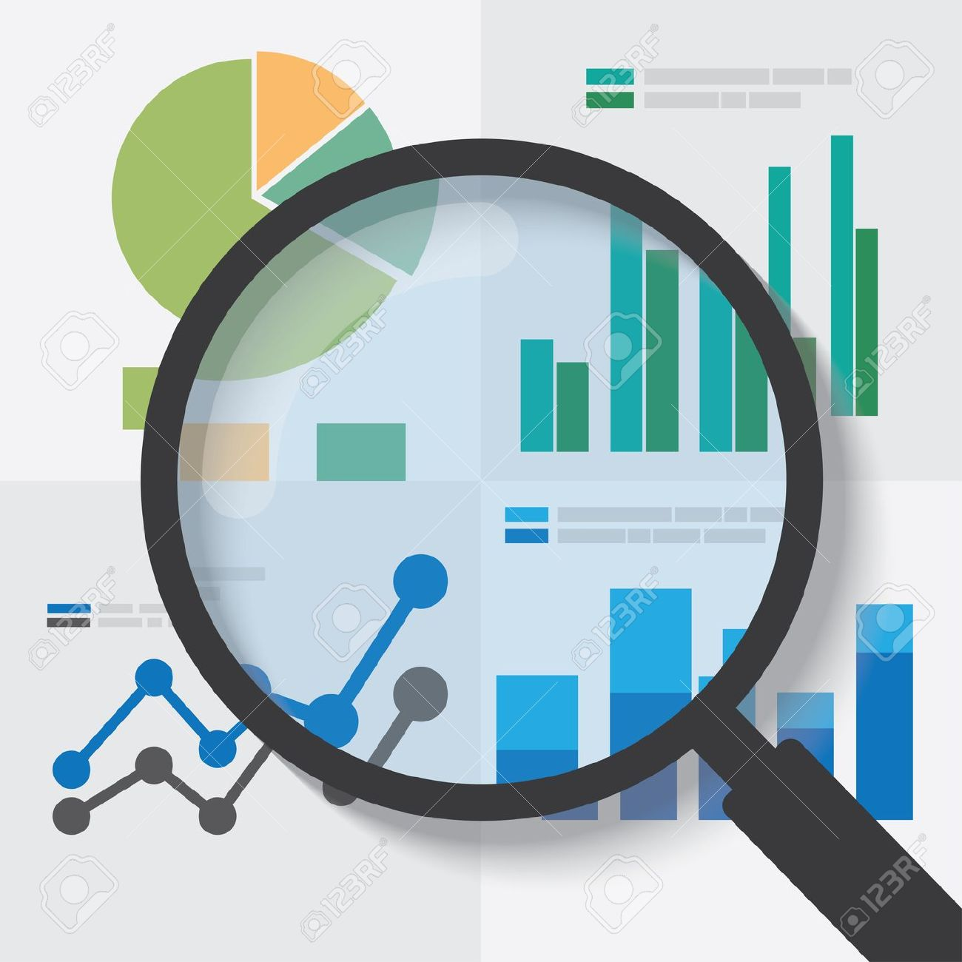
INTRODUCTION
In today’s scenario we can see that mobile apps are playing an important role in any individual’s life. It has been seen that the development of the mobile application advertise has an incredible effect on advanced innovation.
With the fast development of advanced cells, portable applications (Mobile Apps) have turned out to be basic pieces of our lives.
Additionally, application engineers experience issues in discovering how to improve the application execution dependent on generally speaking evaluations alone and would profit by understanding the huge number of printed remarks.

Slide 3
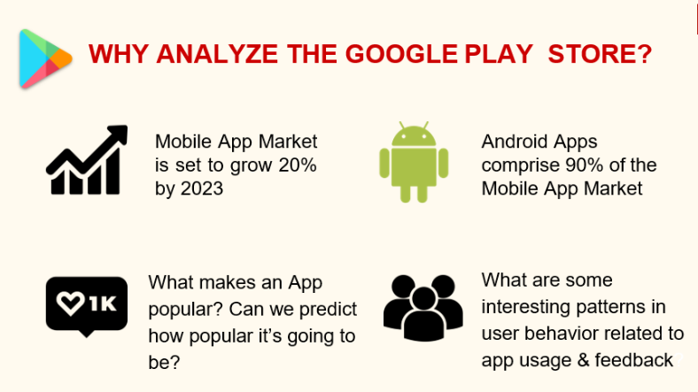


Slide 4
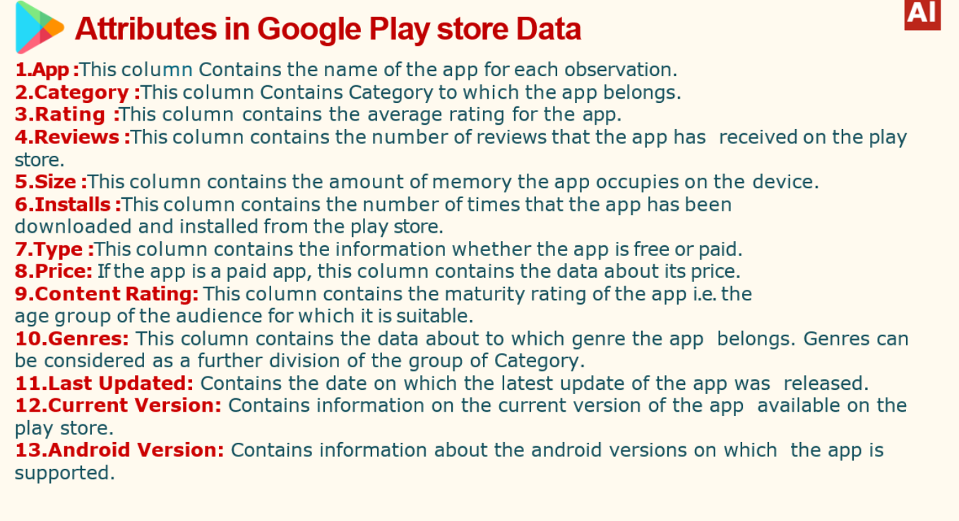

Slide 5
Google Play store Dataset
The dataset consists of Google play store applications. This data set is for Web scratched information of 10841 Play Store applications to analyze the market of android. Here it is a downloaded dataset which a user can use to examine the Android market of different use of classifications music, camera etc.
With the assistance of this, client can predict see whether any given application will get lower or higher rating level. This dataset can be moreover used for future references for the proposal of any application. Additionally, the disconnected dataset is picked so as to choose the estimate exactly as online data gets revived all around a great part of the time. With the assistance of this dataset I will examine various qualities like rating, free or paid and after that will likewise do forecast of various traits like surveys, rating etc.

Slide 6

Problem Statement
We have provided two datasets , One with basic information of Google Play Store application data and other is for User Reviews for those applications.
We must examine and evaluated the data in both datasets in order to identify the important characteristics that influence apps engagement and success.
So what factors are influencing the apps success mostly?
High Average User ‘Rating’
Application Downloads
Application Device compatibility.
Less size and Better speed.
Good Number Of Positive Reviews
Good Number Of Monthly Average Users
High Revenue Per Customer

Slide 7
Python
Most of the info scientist use python due to the good built-in library functions and therefore the decent community. Python now has 70,000 libraries. Python is simplest programing language to select up compared to other language. That’s the most reason data scientists use python for data processing
Specifically, for data scientist the foremost popular data inbuilt open source library is named panda. We can use various graphs, plot, scatterplot, heat maps, graphs, 3-dimensional data python built-in library comes very helpful. This helps in data visualization and in understanding the data way more better.

Slide 8
Data Cleaning
Data cleaning is the process of fixing or removing incorrect, corrupted, incorrectly formatted, duplicate, or incomplete data within a dataset. When combining multiple data sources, there are many opportunities for data to be duplicated or mislabeled. Data Cleaning is a very important step and ensures you only have the most recent files and important documents, so when you need to, you can find them with ease.
If data is incorrect, outcomes are unreliable, even though they may look correct. There is no one absolute way to prescribe the exact steps in the data cleaning process because the process will vary from dataset to dataset.
It includes removing the rows which have absurd or same values. Filtering column values like replacing the null values.

Slide 9
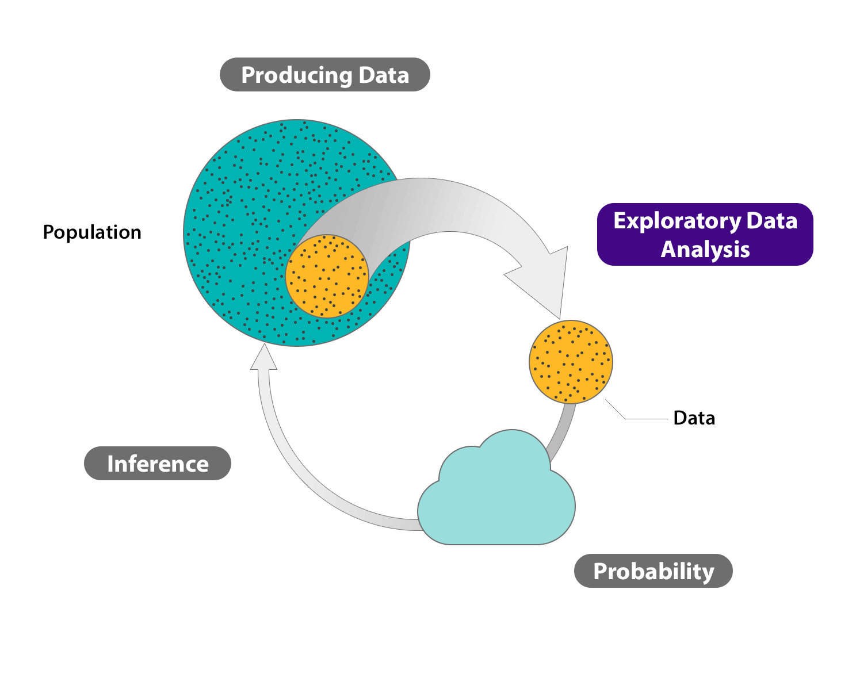
Exploratory Data Analysis (EDA)
Exploratory Data Analysis (EDA) is an approach to analyze the data using visual techniques. It is used to discover trends, patterns, or to check assumptions with the help of statistical summary and graphical representations.
We have worked on two data sets here:
1. Play Store Data
2. User Reviews

Slide 10
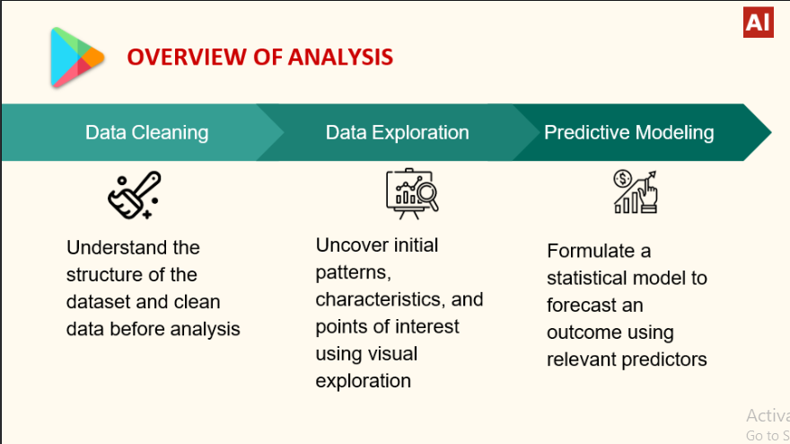

Slide 11
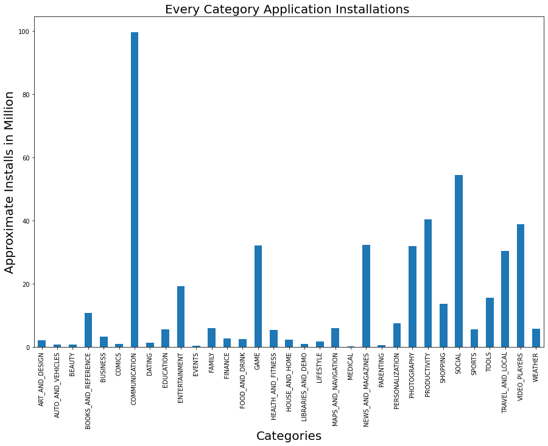
Max Installs in each Category
In this graph the data says that On Playstore most number of downloads are from ‘Communication’ type of applications and then its ‘Social’ Category has secondly maximum installations.
Notes:
This bar graph shows that Communication category has the highest installs and after that social media and so on.

Slide 12
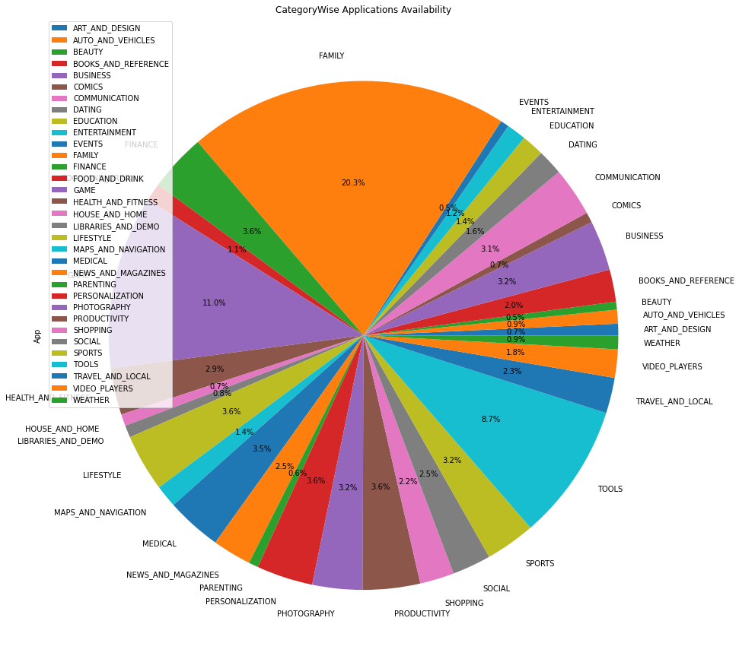
Pie-chart of Category wise applications available
This graph indicates that according to the given data how many applications are available in different categories.
Family Category is having most number of applications and then Game Category is having.
Notes:
This analysis shows that max apps available belongs to category Family and least belongs to Category Events. Also we can study further on diff categories as per the business problems to figure meaningful insights.

Slide 13
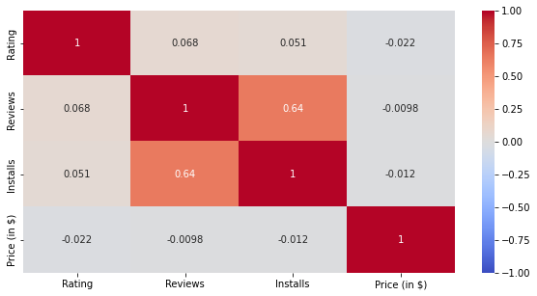
Correlation Matrix/Heatmap among Price, Rating, Install and Reviews
There is a strong positive Correlation between reviews and installs.
The price is slightly negatively correlated with the Rating, Reviews and Installs.
The Rating is Slightly positively correlated with the Installs and Reviews.
Notes:
A heatmap is a graphical representation of data that uses a system of color-coding to represent different values. Heatmaps are used in various forms of analytics. This heatmap shows that Installs and Reviews category here are most related among all others.

Slide 14
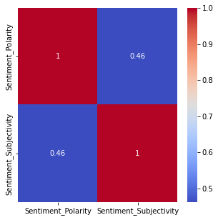
Correlation b/w Sentiment Polarity and Subjectivity
for positive sentiments
There is a slightly positive Correlation between Sentiment Polarity and Sentiment Subjectivity that is provided by the user of Play store applications.

Slide 15
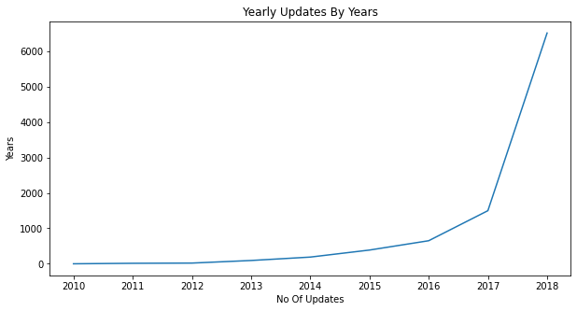
Year wise updates of the Applications
Last updated dates of all the application is plotted in the graph yearwise.
This line plot indicates that most of the application has got updated in year 2018.
Line Graph shows that market is on boom and work is high in Android Market.

Slide 16
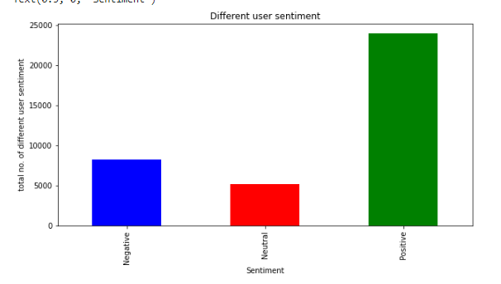
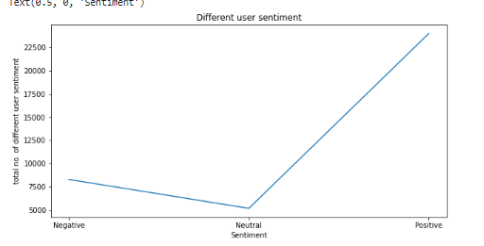
Different user sentiment analysis
In this bar graph we have shown that positive user sentiment is higher than negative user sentiment

Slide 17
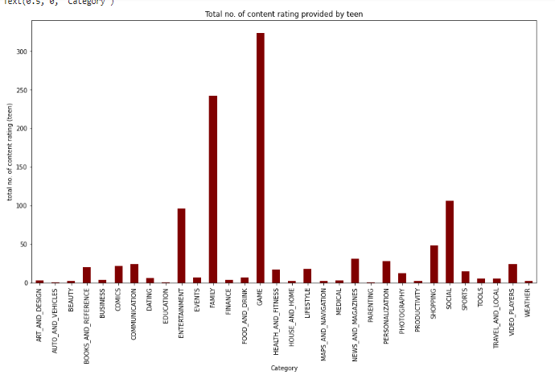
Total number of content rating provided by ‘Teen’
This graph indicates that the game category has most number of content rating provided by ‘Teen’

Slide 18
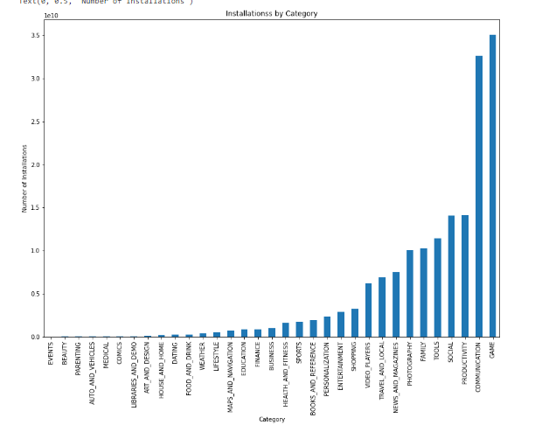
Relation b/w total number of installations per category
In this bar graph we have seen that game category has highest number of installation rate

Slide 19
Conclusion:-
Apps of Category ‘Weather’ has maximum reviews
DS Creator 2.0 is of Category ‘Tools’
Best Food and drink app based on rating is BarB- Q House.
Most of the apps available on play store belongs to Category ‘Family’ i.e, 20.3%Best gaming app based on rating is Monster Ride Pro
Best Art and Design app based on rating is Spring flowers theme couleurs d t space
Apps which have maximum installs are mostly free.
Total No. of Free apps are 8719 & Paid apps are 647
App with least rating is sed on rating is Bar B-Q Rib House
App which generated the highest revenue is Minecraft
Average no. of words used in Translated reviews is 18

Slide 20
11. Highest revenue generated app belongs to Category ‘Family’
12. Most of the apps has got the rating between 3.5 to 5
13. Maximum no. of installations belongs to Category ‘Communication’ and ‘Social Media’
14. Application reviews and installs are highly correlated i.e, 0.64
15. 48 apps are Google listed and their average rating is 4.3
16. Genre ‘Action’ has highest - 358 Gaming applications
17. Maximum no. of applications got updated in year 2018
18. Out of all Categories, ‘Game’ has got the most positive sentiments
19. Game Category has the highest sentiment polarity rate.
20. Maximum installed apps are Subway surfers,Facebook,Messenger & Google Drive
21. Category with has max no. of apps with 4+ rating is ‘Family’
22. Most expensive app on Play store is “I’m Rich” priced at 400$
23. 1208 apps are famous among teens out of 10841 apps

Slide 21


